Slide 1
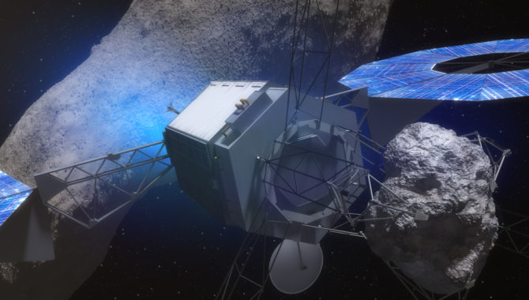
Asteroid
Mining
By: Alema Masina

Slide 2
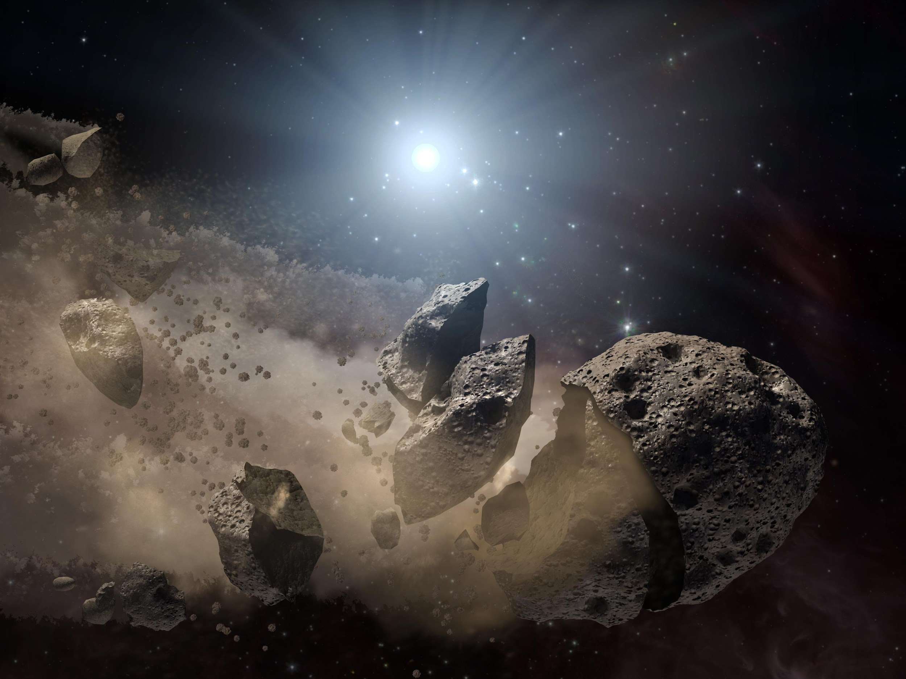
Overview:
History:
Plan and implementation:
Pros:
Cons:
Summary:
References:

Slide 3
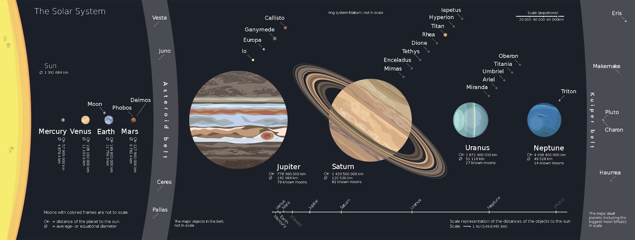
What is Asteroid Mining?
Mining of Celestial close to earth bodies.

Slide 4

History:
1969-72: US Apollo
2005: Hayabusa
2015: US space-mining law
2016: Luxembourg
2017-present: Luxembourg-space mining law
Notes:
1969-72: US Apollo missions bring back moon rocks
2005 Haybusa: recovers dust from itokawa asteroid
2015: US space mining law is the framework for asteroid mining
2016: Luxembourg builds on the 2015 legal precedent
2017-present: Luxembourg-space mining law and follow-up agreements basically just relaxes restriction on private company mining operations beyond earth.

Slide 5

Plan and Implementation
Mining plan
Make it to asteroids
Harvest and return
Notes:
We plan to mine Trillions of dollars worth of ores.
We need to invest in machinery that can make it to the asteroids.
We also need machinery that can harvest and return these ores back to Earth.

Slide 6
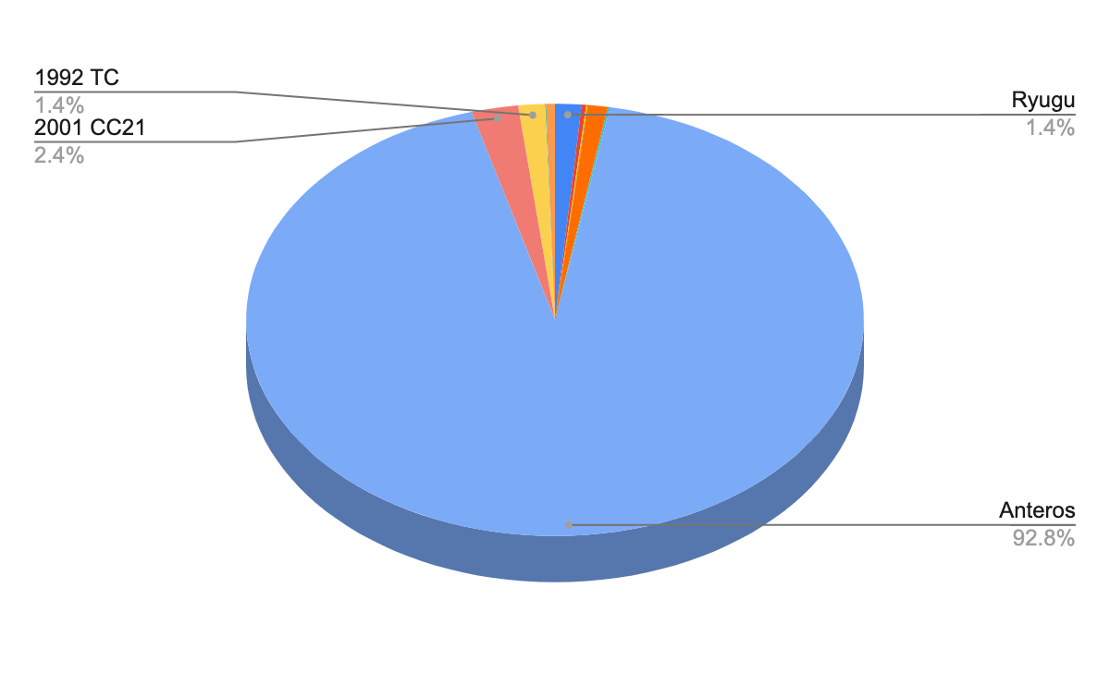
Estimated Value:
Anteros: 5.57 Trillion USD
Ryugu: 83 Billion USD
2001 CC21: 141 Billion USD
1992 TC: 84 Billion USD
Others: ≈2%

Slide 7
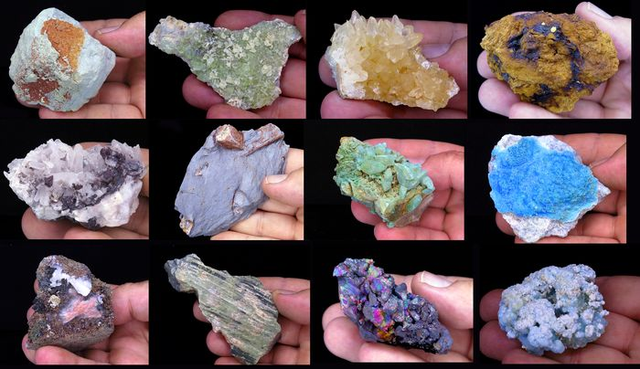
PROS:
Takes away stress
More resources
exploration of our solar system
more jobs
Notes:
Would take stress off of Earth
More resources, for more riches
Enables larger scale exploration of our solar system
Brings more jobs opportunities

Slide 8

CONS:
Contamination
Destroys our environment
Very hard to build
costs a lot of money
Notes:
Could Contaminate the environment
Destroys our environment when we try to build mining rigs
Very hard to build this technology
Will cost a lot of money to build and fund this stuff

Slide 9

Summary:
High cost
Very effective
A lot of jobs
Could help mankind
Notes:
It costs a lot of money but its possible, It is very effective and would allow us to make a lot of money, it helps bring a lot of jobs, would help mankind and could help extend the longevity of our race.

Slide 10
References
History of Space Mining: 5 key events
Unlimited Resources From Space - Asteroid Mining
Pros and Cons of Asteroid Mining

